Slide 1
A Generative Model of People in Clothing
Christoph Lassner, Gerard Pons-Moll, Peter V.Gehler
2017.5.11
Computer Vision and Pattern Recongintion

Slide 2
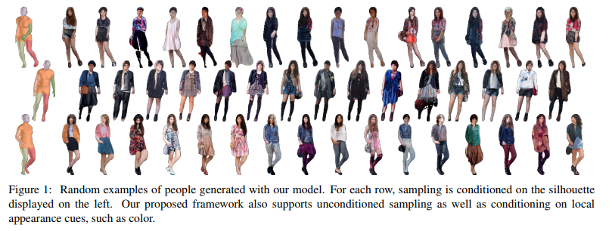
1. Introduction
We present the first image-based generative model of people in clothing for the full body
we address the inverse problem of automatically generating images of people in clothing
the rendering process poses various challenges, all of which are active research topics and mostly require human input

Slide 3

Data Set
The Chictopia10K dataset consists of 17,706 images collected from the Chictopia fashion blog
The Chictopia10K dataset contains fine-grained fashion Labels but no human pose and shape annotation
Dataset are not labeled with clothing information

Slide 4




2. Chictopia made SMPL
Find joint
SMPLify
Sementic segment
Hole filling
Find face

Slide 5
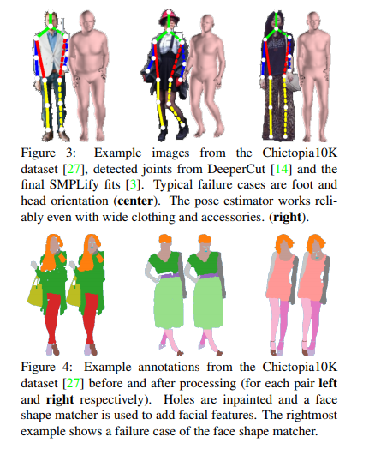
2. Chictopia made SMPL
Preprocessing
we are using a six-part segmented projection of the SMPL fits for conditioning of ClothNet-body
Facial Shape : We use the dlib implementation of the fast facial shape matcher to enhance the annotations with face information
Hole Filling : we apply the morphological “close” and “blackhat” operations to fill the erroneously placed background regions. We carefully selected the kernel size and found that a size of 7 pixels fixes most mistakes while retaining small structures

Slide 6
3. ClothNet
Currently, the most visually appealing technique to create fine-grained textures at 256 × 256 resolution are image-to-image translation networks.
The image-to-image translation model can not handle such multi-modality.
Variational Autoencoders, on the other hand, excel at encoding high variance for similar inputs and provide a principled way of sampling.
the sketch part is variational and deals with the high variation in clothing shape. Its output is a semantic segmentation map (sketch) of a dressed person. The second portray part uses the created sketch to generate an image of the person and can make of use of skip connections to produce a detailed output

Slide 7
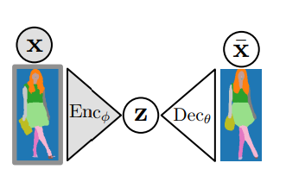


3.1. The Latent Sketch Module
The latent sketch module is a variational auto-encoder which allows to sample random sketches of people.
The Variational Auto-Encoder
Sketch encoding:
VAE
images x
z a 512-D latent space

Slide 8
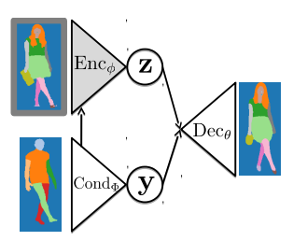

3.1. The Latent Sketch Module
The Conditional Sketch Module
- We use a conditional variational autoencoder for this model
a six part body model silhouette
the losses by weighing the KL component with factor 6.55
Cond is new network about pose and shape
new

Slide 9
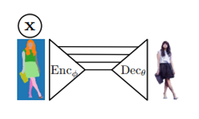
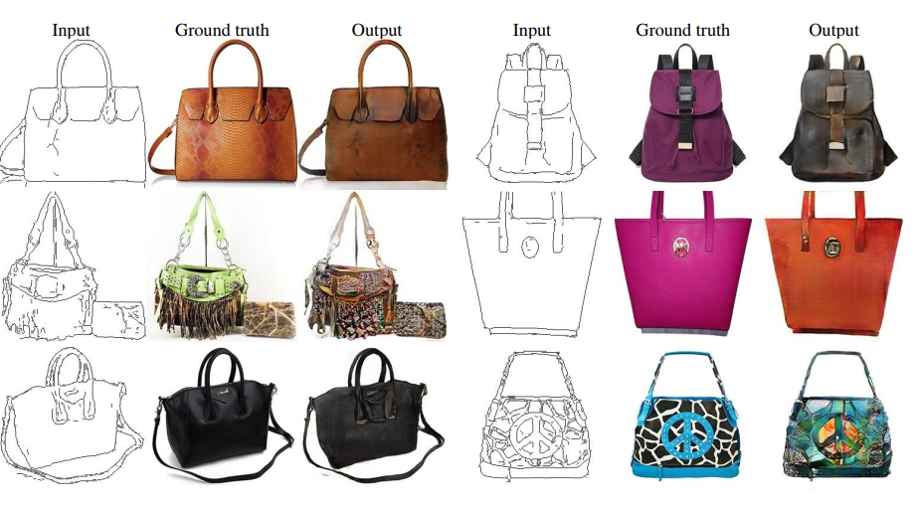
3.2. The portray Module
- the sketch modules can be chained to a portray module
- image-to-image translation model

Slide 10
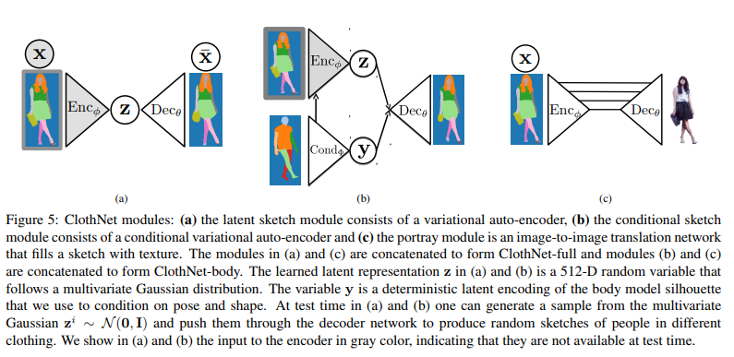
3.4. ClothNet Pipeline

Slide 11
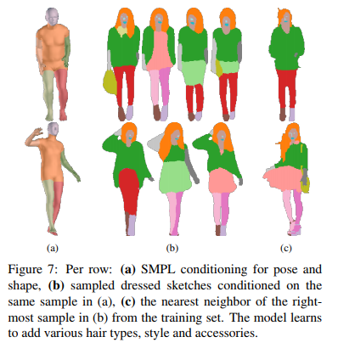
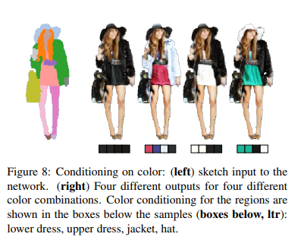
4. Experiments

Slide 12
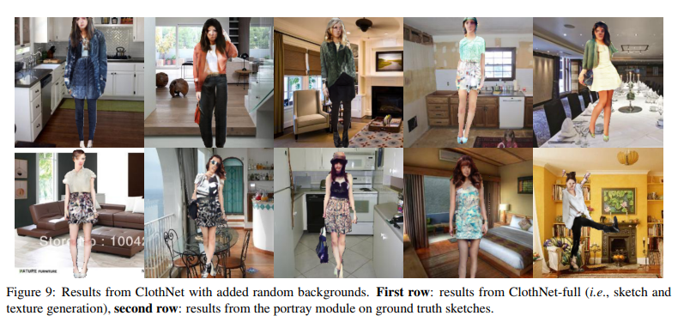
4. Experiments

Slide 13
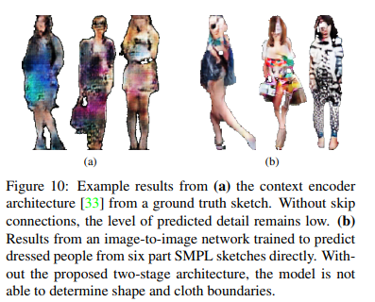
4. Experiments
- If you don't preprocess, the result will not be good.

